Slide 1
CSCI U511 01 Operating Systems AKM Jahangir A Majumder, PhD
Fall 2019 - Lecture 7
Sept. 12, 2019
Note: Some slides are adapted from those used by previous instructors and some slides include figures from the textbook.

Slide 2
Review and Learning Outcomes
We finished to discuss Chap. 3: The Programming Interface today
We will continue to discuss Chap. 4: Concurrency and Threads today
Implementing Threads
Multi-threaded OS Kernel
Thread Context Switch
Quiz 1 grades and keys are posted on Blackboard
We will have Quiz 2 on Thursday, September 19, which will cover lectures 4-7
HW 1 key and grades are posted on Blackboard
HW 2 is posted on Blackboard which is due on Tuesday
We will start to discuss project progress today

Slide 3
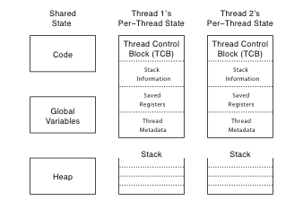
Thread Data Structures
A multi-threaded OS has both per-thread state and shared state
TCB stores per-thread state: thread computation current state and data to manage the thread

Slide 4
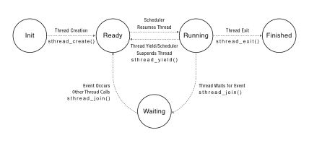
Thread Lifecycle
Notes:
Labels should be thread_create() not sthread_create, etc.

Slide 5
Implementing Threads: Roadmap
Kernel threads
Thread abstraction only available to kernel
To the kernel, a kernel thread and a single threaded user process look quite similar
Multithreaded processes using kernel threads (Linux, MacOS)
Kernel thread operations available via syscall
User-level threads
Thread operations without system calls

Slide 6
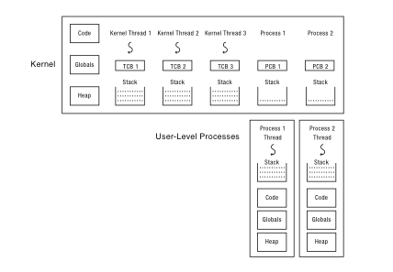
Multithreaded OS Kernel
A multi-threaded kernel with three kernel threads and two single threaded user level processes
Each kernel has own TCB and stack. Each user process has a stack at user-level and a kernel interrupt stack

Slide 7
Implementing threads
Thread_fork(func, args)
Allocate thread control block
Allocate stack
Build stack frame for base of stack (stub)
Put func, args on stack
Put thread on ready list
Will run sometime later (maybe right away!)
stub(func, args): OS mips_threadstart
Call (*func)(args)
If return, call thread_exit()

Slide 8
Thread Stack
What if a thread puts too many procedures on its stack?
What will happen in different programs

Slide 9
Thread Context Switch
Mechanism to switch which threads are RUNNING and which are READY
Suspends execution of a currently running thread and resumed execution of some other threads
Voluntary
Thread_yield
Thread_join (if child is not done yet)
Involuntary
Interrupt or exception
Some other thread is higher priority

Slide 10
Voluntary thread context switch
Save registers on old stack
Switch to new stack, new thread
Restore registers from new stack
Return
Exactly the same with kernel threads or user threads
OS: thread switch is always between kernel threads, not between user process and kernel thread

Slide 11
OS/161 switchframe_switch
/* a0: old thread stack pointer
* a1: new thread stack pointer */
/* Allocate stack space for 10 registers. */
addi sp, sp, -40
/* Save the registers */
sw ra, 36(sp)
sw gp, 32(sp)
sw s8, 28(sp)
sw s6, 24(sp)
sw s5, 20(sp)
sw s4, 16(sp)
sw s3, 12(sp)
sw s2, 8(sp)
sw s1, 4(sp)
sw s0, 0(sp)
/* Store old stack pointer in old thread */
sw sp, 0(a0)
/* Get new stack pointer from new thread */
lw sp, 0(a1)
nop /* delay slot for load */
/* Now, restore the registers */
lw s0, 0(sp)
lw s1, 4(sp)
lw s2, 8(sp)
lw s3, 12(sp)
lw s4, 16(sp)
lw s5, 20(sp)
lw s6, 24(sp)
lw s8, 28(sp)
lw gp, 32(sp)
lw ra, 36(sp)
nop /* delay slot for load */
/* and return. */
j ra
addi sp, sp, 40 /* in delay slot */

Slide 12
x86 switch_threads
# Save caller’s register state
# NOTE: %eax, etc. are ephemeral
pushl %ebx
pushl %ebp
pushl %esi
pushl %edi
# Get offsetof (struct thread, stack)
mov thread_stack_ofs, %edx
# Save current stack pointer to old thread's stack, if any.
movl SWITCH_CUR(%esp), %eax
movl %esp, (%eax,%edx,1)
# Change stack pointer to new thread's stack
# this also changes currentThread
movl SWITCH_NEXT(%esp), %ecx
movl (%ecx,%edx,1), %esp
# Restore caller's register state.
popl %edi
popl %esi
popl %ebp
popl %ebx
ret

Slide 13
A Subtlety
Thread_create puts new thread on ready list
When it first runs, some thread calls switchframe
Saves old thread state to stack
Restores new thread state from stack
Set up new thread’s stack as if it had saved its state in switchframe
“returns” to stub at base of stack to run func

Slide 14
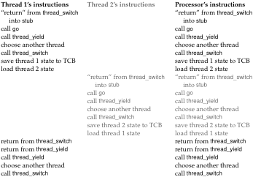
Two Threads Call Yield

Slide 15
Involuntary Thread/Process Switch
Timer or I/O interrupt
Tells OS some other thread should run
Simple version (OS/161)
End of interrupt handler calls switch()
When resumed, return from handler resumes kernel thread or user process
Thus, processor context is saved/restored twice (once by interrupt handler, once by thread switch)

